Slide 1

How Metal AM Is Driving the Future of Tooling
June 8, 2023
Notes:
Image behind the gradient mask

Slide 2


Your Velo3D Experts
Paul Hollowaty
Sales Director
paul.hollowaty@velo3d.com
Michael Harsch
Technical Sales Engineer
michael.harsch@velo3d.com

Slide 3
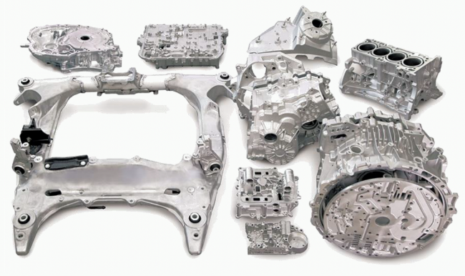
The Challenge of Casting
Large parts
High temperatures
Pressure on quicker production

Slide 4
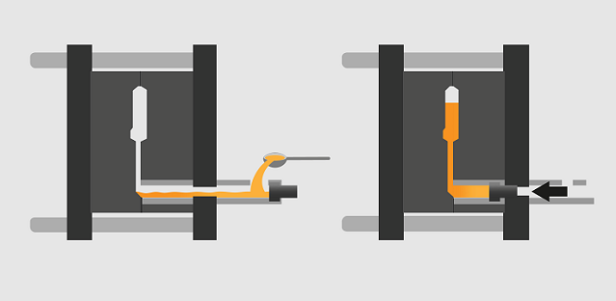
Aluminum Die Casting
Molten aluminum placed into shot sleeve
  Up to 80 kg of metal in a pour
  Temperature of ~610 ° C
Shot plunger injects metal into cavity (20 ms)
  40 km/hr injection speed
  Every 1-2 min turnover time

Slide 5
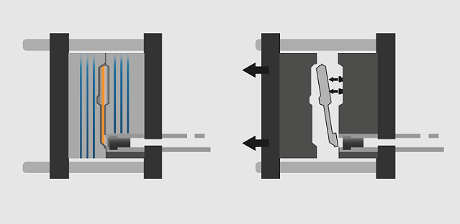
Aluminum Die Casting
Part cools fully (60° C)
  Last section to cool limits cycle time of entire casting
  Any molten metal has risk of exploding
  Last section to solidify holds highest porosity
  Every cooling line is two plumbing connections with risks of leaking
4. When sufficiently solid, the die open and pins eject the part off the die
  Target of 1,000 castings / day

Slide 6
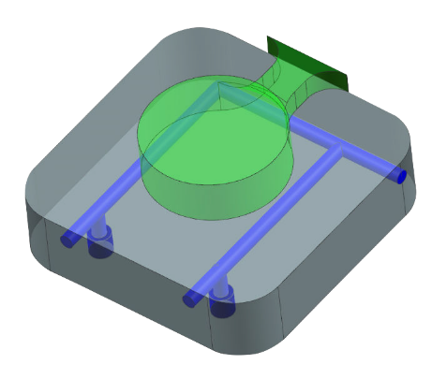
Challenges of Typical Cooling Strategies
Example: Biscuit Cooling
Straight line drilling
Need plugs for drill lines – plugs fail early
Creates right angle intersections – early failure point
Non-optimal cooling – less productive
Plugs

Slide 7
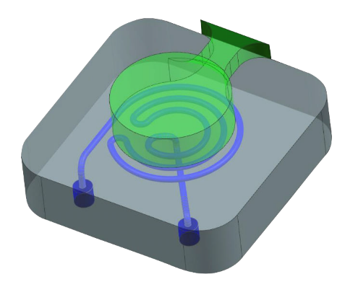
Advantages of Conformal Cooling
Example: Biscuit Cooling
Eliminates plugs (same water entry and exit)
Eliminates right angles
Able to mold to hot spots
Reduces cycle times
Able to move porosity to lower risk areas

Slide 8
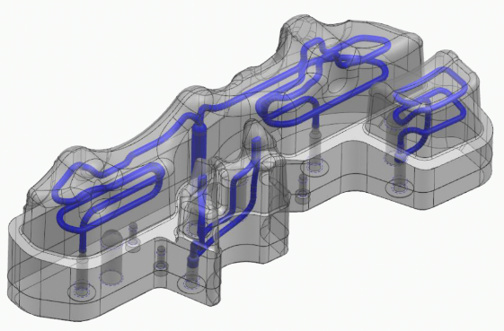
The Next Generation of Tooling
Advanced cooling strategies
Enable faster production times by speeding up the cooling at hot spots in the mold
AM used to manufacture sub-inserts providing conformal cooling in specific areas
However, this is non-trivial to implement

Slide 9
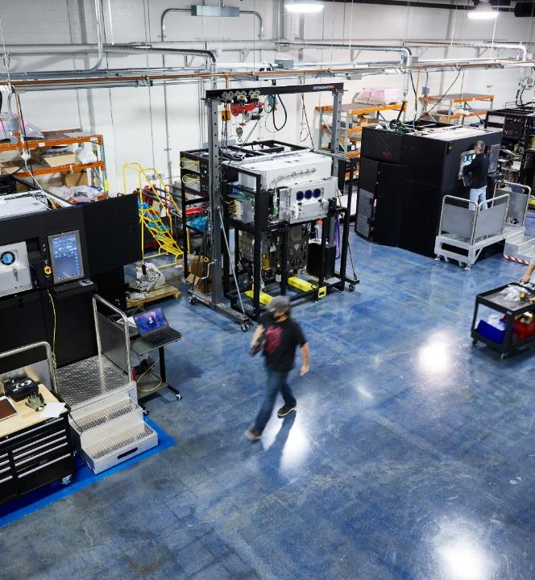
Enabling the Future of Tooling

Slide 10
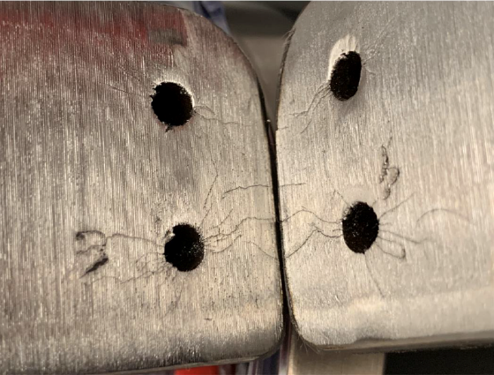
Why AM-enabled Conformal Cooling is Hard
Current Die Cast Tools:
Limited AM chamber sizes (300 mm)
Small diameter (8 mm) max cooling line size
Marginal shot life improvements (~30k)

Slide 11
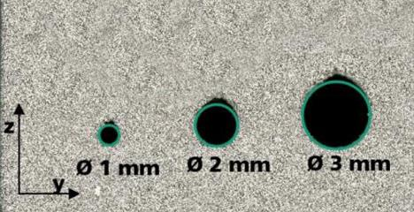
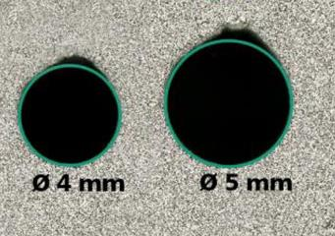
Why AM-enabled Conformal Cooling is Hard
Hole diameters limited by ability to print with high quality surface finish
Close out on top of channel especially hard
Higher roughness leads to crack propagation
High thermal stresses (600° C to 60° C, 1,000x per day)

Slide 12
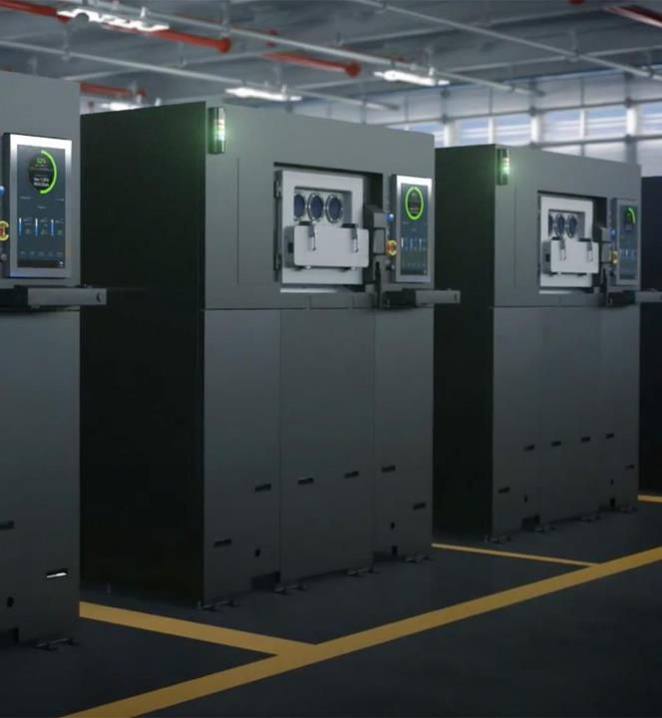
Fully Integrated Metal
3D Printing Manufacturing Solution

Slide 13
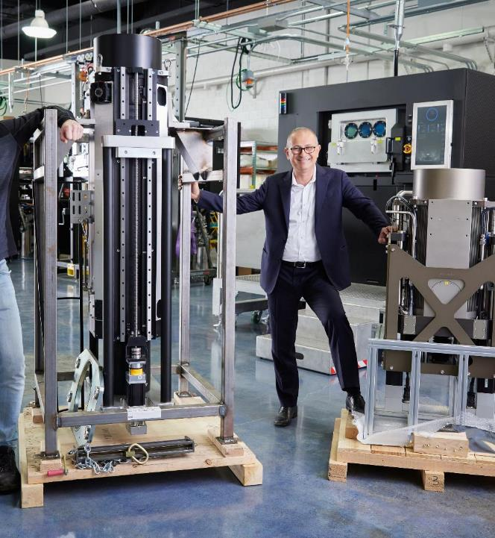
Our Story
USA company founded in 2014
Public Company - NYSE “VLD” since Sept. 2021
Revolutionary fully integrated metal AM solution
Enables production of complex, high-value metal parts
Service and support worldwide
Notes:
Before we jump into the advanced in metal 3D manufacturing there may be some of you in the audience today that do not know who we are.
We are the only major metal AM manufacturer who designs and produces our systems in the US

Slide 14



















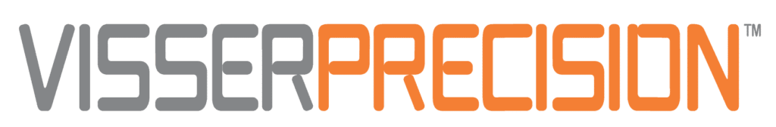



Diverse Customer Base
Space
Aviation / Defense
Energy / Industry
Contract Manufacturing

Slide 15
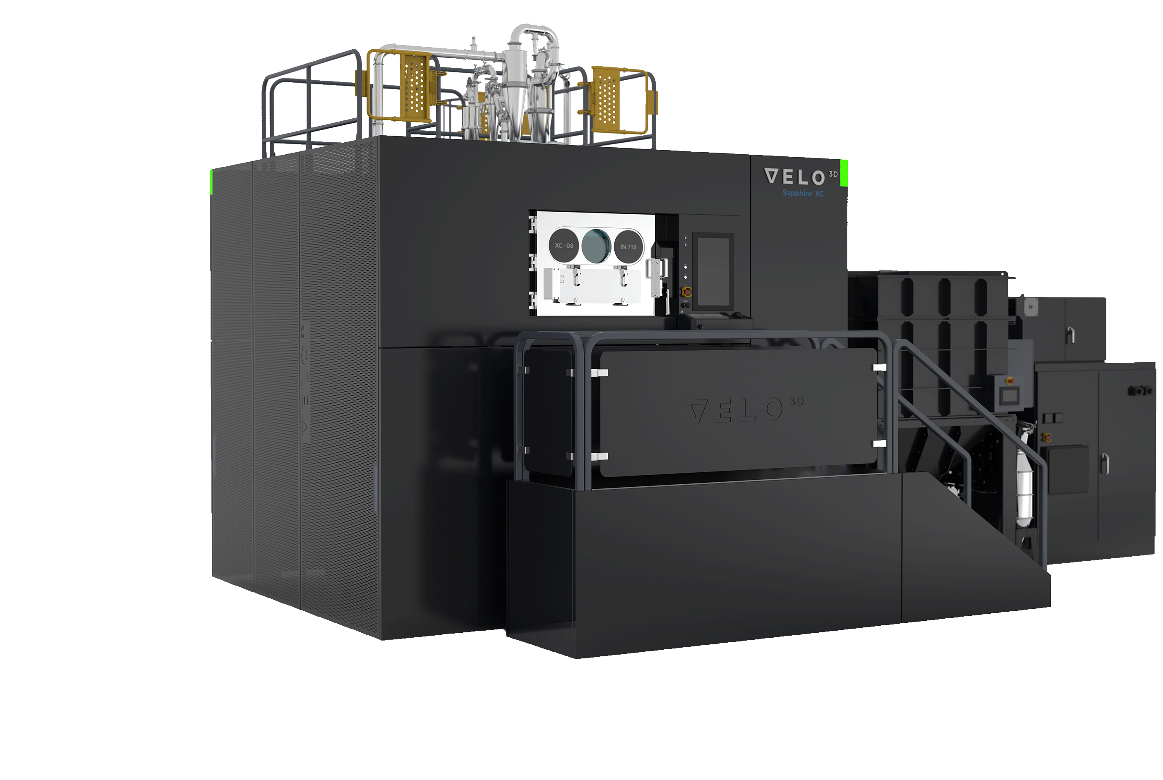
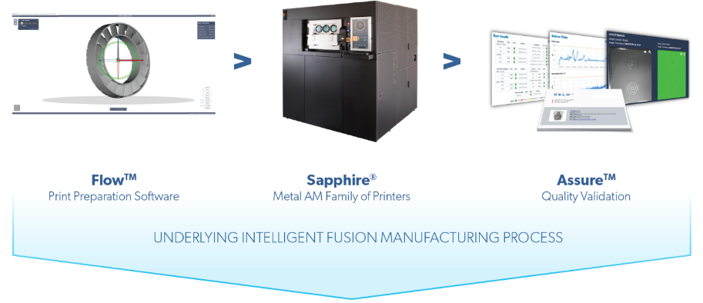


Velo3D Fully Integrated Metal AM Solution
Design freedom, agility, repeatability, quality, greater control
Notes:
We use the same lasers and optics, gas glow is identical. Sapphire XC uses the same process as Sapphire with minimum build changes. Same process.
Intelligent Fusion, feature based recognition, process parameters applied to features automatically,

Slide 16
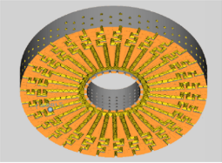
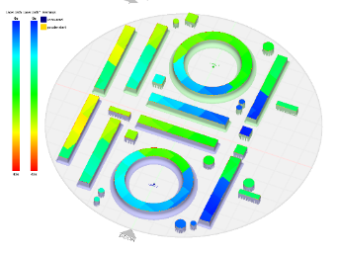
Flow Pre-Print Software
Flow
Build Preparation
CAD file import
Orient and Support the part
Apply sub-processes
Populate the build plate
Slice the part into 2D sections
Generate laser instructions
Review prepared print file
Flow
Process Review
Produces the Velo3D Golden Print File
Notes:
Integrated software simplifies the learning curve
Identical results regardless of engineer performing work

Slide 17
Sapphire Printer Family
State-of-the-art laser powder bed fusion metal AM printers featuring, optimized gas flow, and a unique non-contact recoater
Lasers
  Sapphire & Sapphire 1MZ: 2, 1 kW lasers
  Sapphire XC & Sapphire XC 1MZ: 8, 1 kW lasers
  In-situ laser alignment
50-150 μm Layer Thickness
Automated Calibrations
In-situ Monitoring (nearly 1,000 signals)
Sapphire
315 mm ø x 400 mm Z
Sapphire 1MZ
315 mm ø x 1000 mm Z
Sapphire XC
600 mm ø x 550 mm Z
Sapphire XC 1MZ
600 mm ø x 1000 mm Z
Notes:
All Printers Use The Same Software AND Processes
All Use Same High-Quality Materials
Golden-Print File Works Across Any Printer
Identical results regardless of operators performing calibration

Slide 18
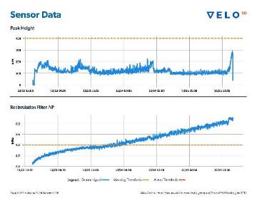
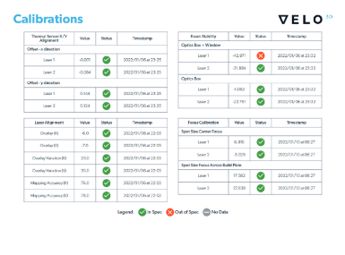

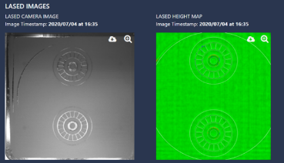
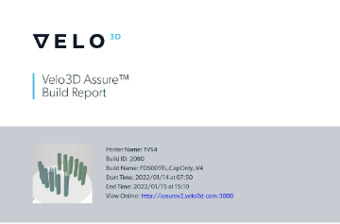
Assure – Quality Control Software
Factory Monitoring
  Real-time machine fleet tracking
  Live build progress monitoring
Tool Health
  Automated system calibration
In-process monitoring
  Optical health
  Powder bed quality
  Build chamber environment
Build Report
  Build information summary
  Tool and build data documentation
Notes:
Machine 2.1x2.1x2.1 meters
Provide all technical documentation for you to integrate into your site
Velo3D has validated that it can print at Equivalent or Better material properties to cast parts. Our material density and geometric accuracy enable customers to transfer parts that will be or have previously been cast to 3d printing with no loss in quality. This should enable a faster, easier certification process to authorities.

Slide 19
How Velo3D Enables Metal AM Production

Slide 20

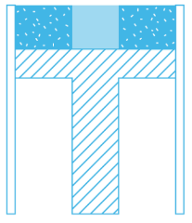
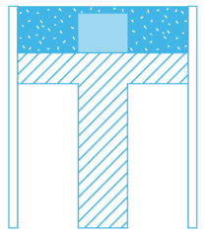
What is Laser Powder Bed Fusion (L-PBF)?
Laser melting of
powder to form object
Piston steps down
Recoating of Powder

Slide 21
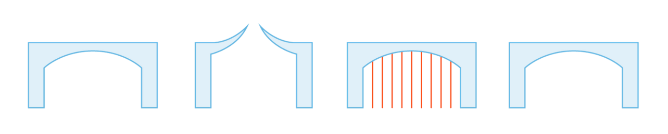
Why are Supports Needed?
Supports are really anchors, preventing the part from destroying itself.
The desired outcome
Outcome with conventional AM, without supports
Supports added, as anchors to prevent part destruction in build
Velo3D Outcome
Working towards no DfAM
Notes:
Problem: Stress
Pain: Supports
Crisis: Cannot MFG quality / usable parts

Slide 22
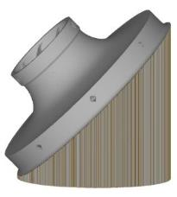
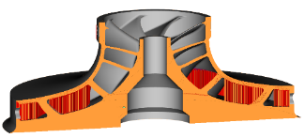
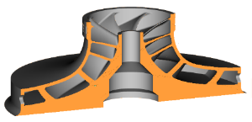
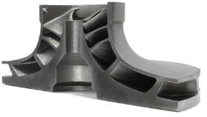
Approaches to Printing Impellers
Conventional AM
Supports Orientation
Velo3D
Without Compromise
Notes:
Problem: Stress
Pain: Supports
Crisis: Cannot MFG quality / usable parts

Slide 23
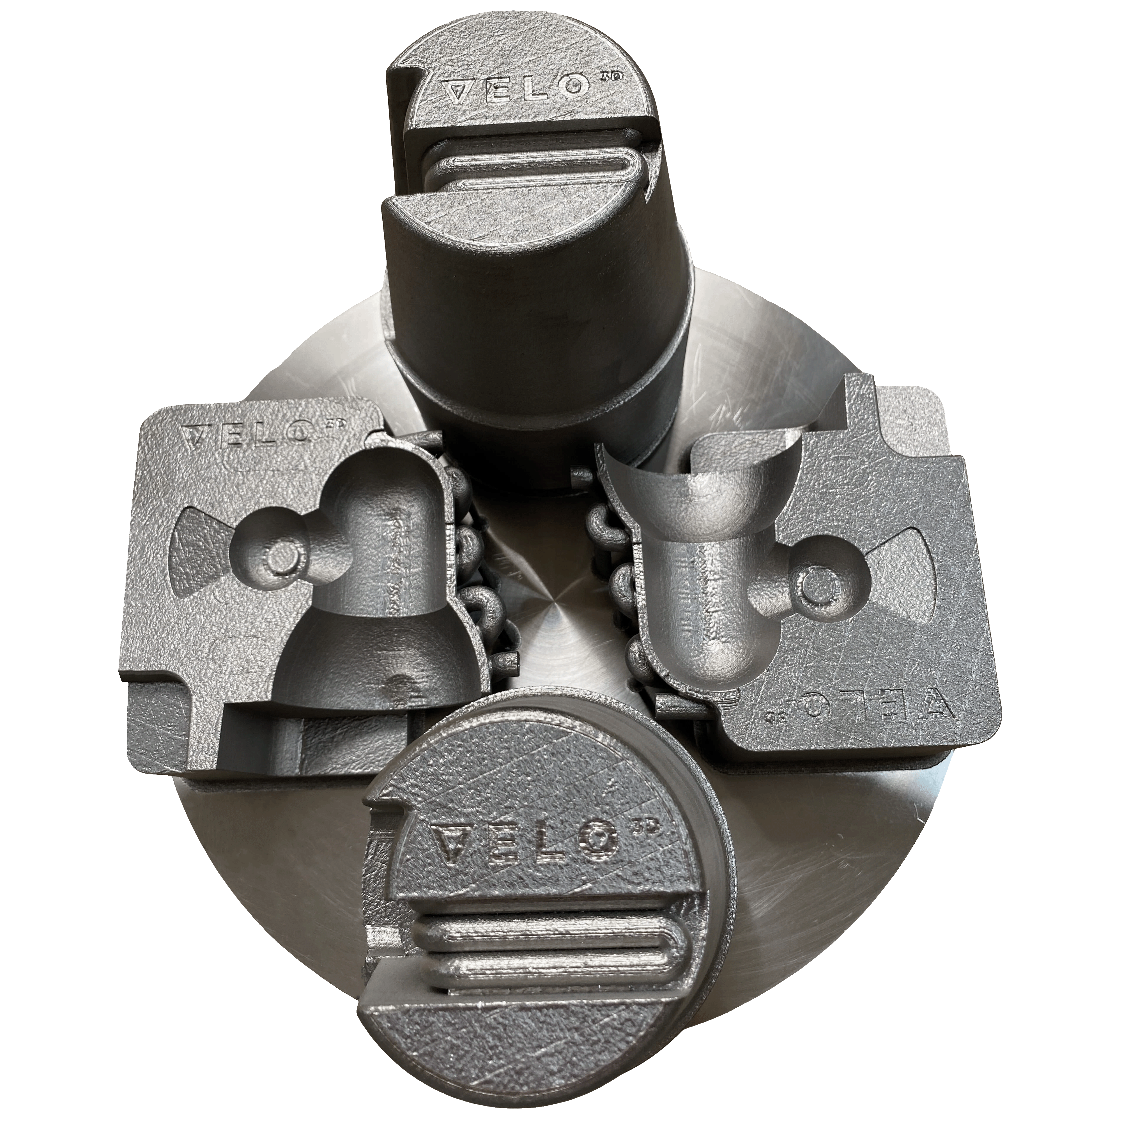
Advantages of Velo3D Technology
Specialize in producing parts that optimize the flow of fluids or exchange of heat
Overcome the dependency for supports in many applications
Novel hardware
In-house parameter set development
Demonstrated commercial viability to print improved cooling channels
  Up to 100mm with higher quality surface finish
  Minimal downskin degradation
Confidential & Proprietary |
23

Slide 24
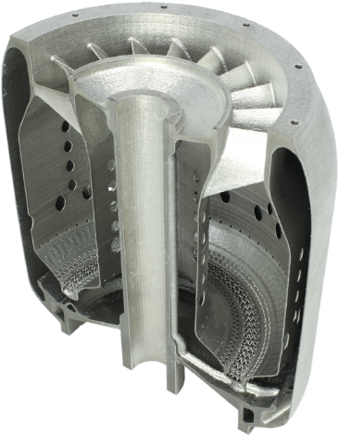
Geometric Capabilities that Meet Material Standards
Flow print preparation
Includes in-house developed parameter sets for specialized printing challenges
Automatically applies solutions based on part geometry
Allows user overrides to alter material properties or print specialized features
Bulk
Vertical walls
Low angle closures
Low angle walls
Lattice

Slide 25
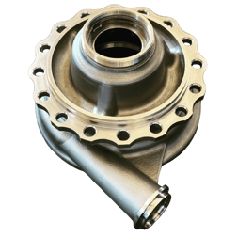
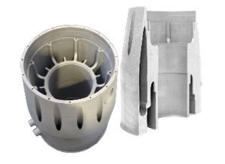
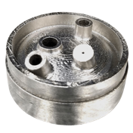
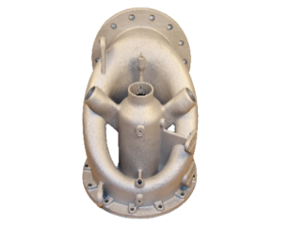
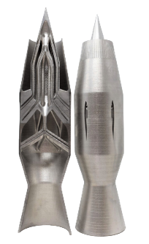
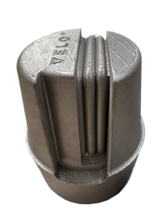
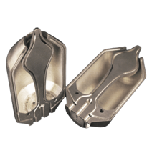
Internal Channels
Velo3D Benefits:
Improved surface finish on internal channels for reduced back pressure and lower risk of fatigue cracking
Larger internal channels (100 mm vs 5 mm) for better flow characteristics
Able to keep internal channels round vs tear drop or diamond shape (DfAM) to reduce cracking
Example parts:
Launcher volute; Crossover; Kw Housing Generator; Manifolds; Spiral Tubing; Ramjet; Aerospike; HPDC insert; injection molding insert

Slide 26
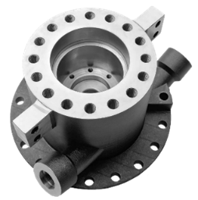
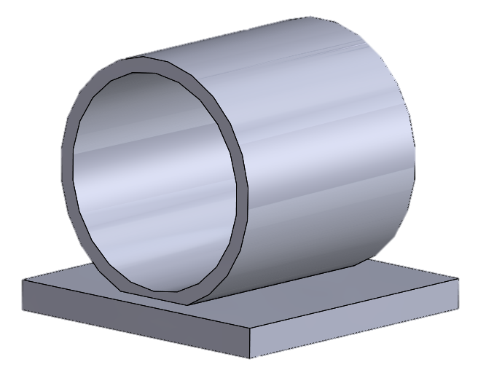
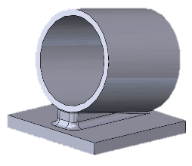
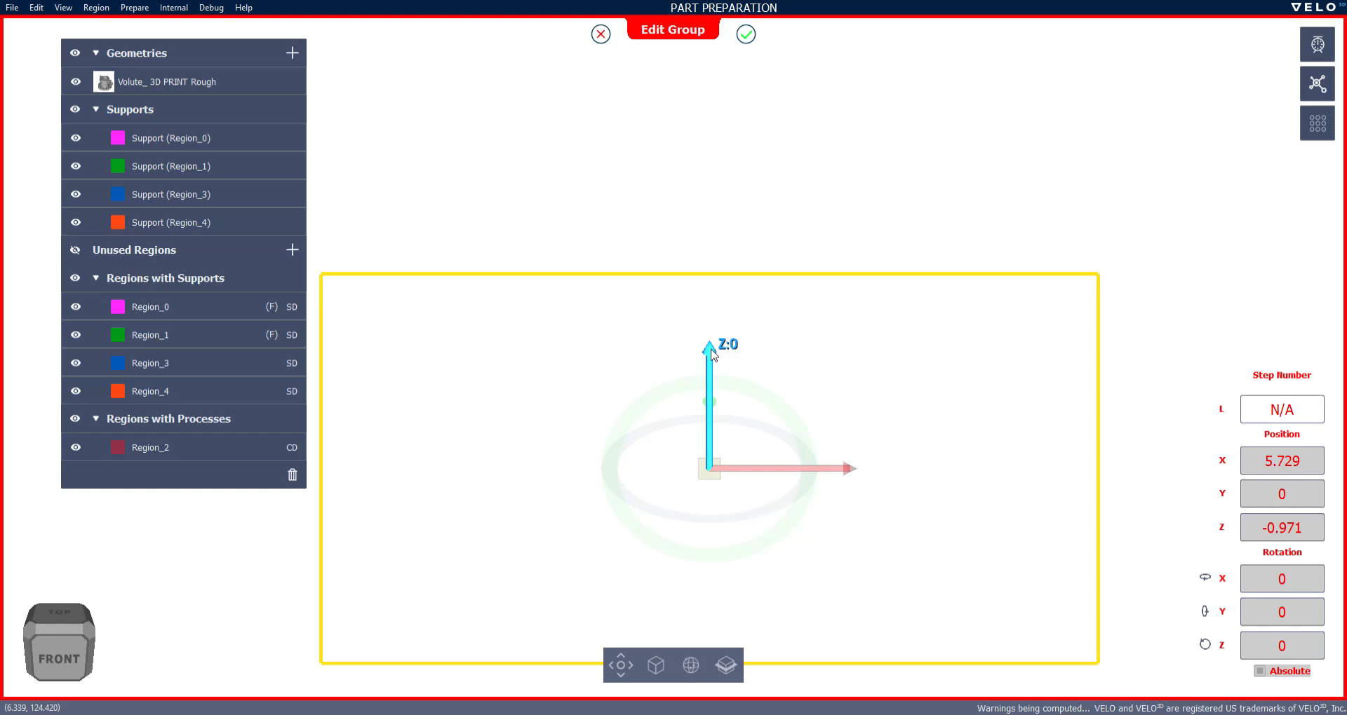
Circular Holes
Horizontal Tube
Tilted Tube
Maximum ID = 100 mm+
Minimum ID = 500 µm
Maximum ID = 100 mm++
Minimum ID = 500 µm
Surface finish at closure improved when tilted

Slide 27
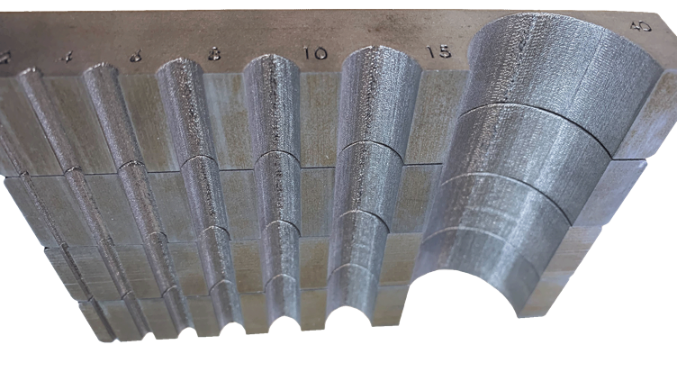
Cooling Channel Results
M300 channels
No significant erosion of the downskin at the top of these channels, even at 40mm + diameter profiles
Critical for fatigue life of printed tools. Erosion of the downskin will contribute to crack initiation sites

Slide 28
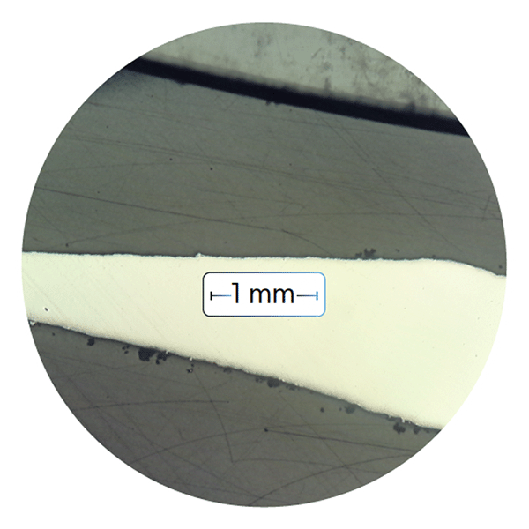
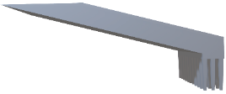
Low-Angle Surface Finish
Micrograph Image
15° downskin
800
600
400
200
0
Vertical
Roughness Sa (µin)
Roughness Ra (µm)
Roughness Ra (µin)
Inconel 718; 50 µm layers;
Stress relief to ASTM 3055,
HIP per ASTM F3055, solution
& aged per AMS 5662
Notes:
RTB: surface finish

Slide 29
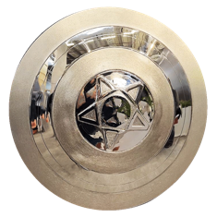
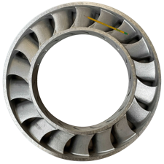
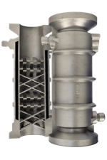
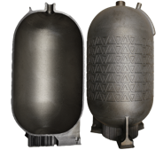
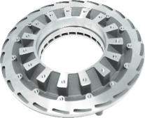
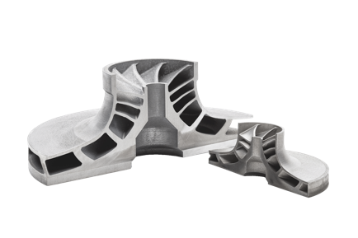

Low Angle Features
Velo3D Benefits:
Print without supports or tilting
Can print with better internal surfaces
Can print flat which keeps the part round and easier to balance (high RPM)
Example parts:
Stator Rings / Blisks; Impellers; Diffusors; Static Mixers; Pressure Tanks; Inducers; Radial Turbine Wheels; Captain AM Shield

Slide 30






Thin Wall Features
Velo3D Benefits:
Improved heat transfer and reduced back pressure
Print in a single piece eliminating weld and braze joints
Reproduce geometries at a smaller scale that were previously only possible with larger designs.
Complex assemblies leveraging part consolidation
Example Parts:
Siemens gas turbine diffuser; Sierra Turbine microturbine; Bell Heat Exchanger; Combustion Liner; PWR Heat Exchanger; Radial Heat Exchanger; Rocket Chamber Nozzle; Nozzles

Slide 31

M300 Tool Steel
Ultra-low carbon alloy with very high strength & hardness, comprised mainly of nickel, with cobalt, molybdenum, & titanium as secondary intermetallic alloying metals.
Maraging tool steel is a proven material for the die & tooling industry
Mechanical Properties at Room Temperature
Confidential & Proprietary |
31

Slide 32

Fleet-Level Standardization
Controlled Parameters:
Qualifiable set of generalized parameters
Driven by real world applications over time with industry leaders
Constantly generating pedigree data on material properties
Enables establishment of material property datasets at the fleet / equipment supplier level
Crates a consistent supply chain for in-house or CM-sourced manufacturing

Slide 33







Get The Same Part – No Matter Where You Print
*.veloPrint
(Golden Print File)
OEM
Contract Manufacturing Network
Initial
qualification
All Sapphires
at Supplier A
All Sapphires
at Supplier B
All Sapphires
at Supplier C

Slide 34


Velo3D’s CM Network
Global Contract Manufacturing Network
*Distributor with printing capabilities only

Slide 35










Velo3D Opens New Categories of Metal AM Parts
Parts Optimized to Control Flow of Fluids and/or the Transfer of Heat

Slide 36
Thank You!
Questions?
All Rights Reserved ©Velo3D 2023
Velo, Velo3D, Sapphire and Intelligent Fusion are registered trademarks of Velo3D, Inc. Without Compromise, Flow and Assure are trademarks of Velo3D, Inc.

Slide 37



Production-Ready Material Processes
Inconel® 718 / Inconel® 625
Copper GRCop-42 / C18150
Hastelloy® X / Hastelloy® C-22 ®
Aluminum Aheadd® CP1 / F357 / Scalmalloy®
forAM® Haynes® 282®* / Haynes® 214 ®
Titanium Ti-6Al-4V
Steel M300
Coming Soon:
Stainless Steel
Contact us for qualification of your material
Partner vendors available to easily source powder
Powder purchased from major vendors; manufacturer flexible
Specific material property data available upon request
*Produced by Höganäs under License from Haynes International, Inc.

